Slide 1

Department of CSIT
COURSE NAME
FOUNDATIONS OF CLOUD-NATIVE COMPUTING & DEVOPS
COURSE CODE –24CS2260F
Topic:
Caching for faster builds
Session -

Slide 2


Slide 3
A High-Level Overview: What is Caching?
Caching is about avoiding work by keeping frequently needed resources easily accessible. It accelerates repeated processes by storing previously used data or outputs for quick retrieval, leading to shorter build durations.
This not only saves time but also improves workflow efficiency, allowing developers to concentrate on core development tasks rather than waiting on build processes.
What is Build Caching?
Build caching aims to reduce redundant work by storing outputs of intermediate build steps, like compiled code or test results, for reuse in subsequent builds.
This approach prevents the need to repeat identical processes in future builds and can speed up iteration cycles

Slide 4
Docker layer caching
If your application relies on containers, you may find yourself building the same image on every run of your CI/CD pipeline, which can be a serious drain on your build minutes.
By enabling Docker layer caching, you can achieve a significant reduction in build times by reusing cached image layers rather than building them from scratch each time.
How to add Docker layer caching to your pipelines:
You can use Docker layer caching to speed up Docker image builds in both the Docker and the machine execution environments.
In the Docker execution environment, any Docker images that you create are built in a secondary container called the remote Docker environment.

Slide 5
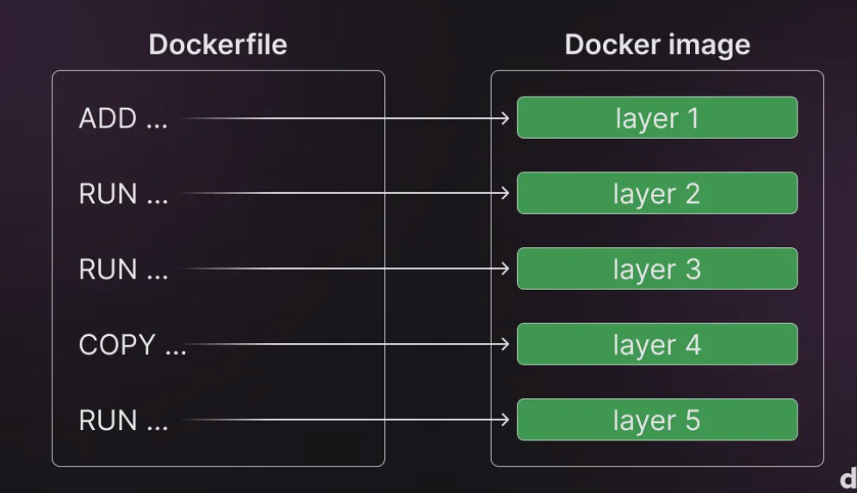
Optimize cache usage in builds
When building with Docker, a layer is reused from the build cache if the instruction and the files it depends on hasn't changed since it was previously built.
Reusing layers from the cache speeds up the build process because Docker doesn't have to rebuild the layer again

Slide 7
Here are a few techniques you can use to optimize build caching and speed up the build process:
Order layers: Arrange commands in a logical order to avoid unnecessary cache invalidation.
Keep context small: Reduce the files sent to the builder to minimize data transfer and cache invalidation.
Use bind mounts: Mount host files into the container to avoid extra layers and speed up builds.
Use cache mounts: Set up a persistent package cache to avoid re-downloading packages during builds.
Use an external cache: Store build cache remotely to share across builds and environments.

Slide 8
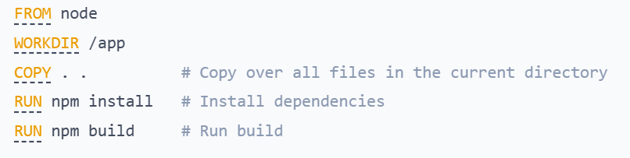
Order your layers
Try to make expensive steps appear near the beginning of the Dockerfile.
Steps that change often should appear near the end of the Dockerfile, to avoid triggering rebuilds of layers that haven't changed.
Consider the following example. A Dockerfile snippet that runs a JavaScript build from the source files in the current directory:
This Dockerfile is rather inefficient.

Slide 9
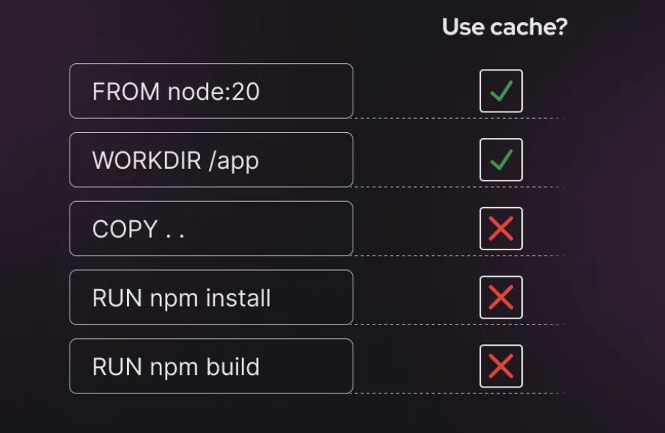

Slide 10
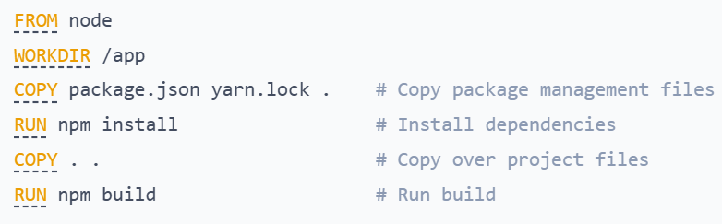
Instead, the COPY command can be split in two. First, copy over the package management files (in this case, package.json )
Then, install the dependencies. Finally, copy over the project source code, which is subject to frequent change.
By installing dependencies in earlier layers of the Dockerfile, there is no need to rebuild those layers when a project file has changed.

Slide 11
The following approach enables Docker layer caching in GitHub Actions workflows:
Docker Buildx: docker/setup-buildx-action@v2 is used to enable advanced build capabilities.
Caching: actions/cache@v2 caches Docker layers to speed up builds. It uses a key based on the GitHub SHA to identify different builds.
Docker Build: The docker buildx build command builds the image and uses caching with --cache-from and --cache-to to store and reuse layers
In Jenkins
To enable Docker caching, you can use a Docker Buildx or Docker layer cache plugin, or simply leverage Docker's native cache mechanisms with the appropriate build commands.

Slide 12
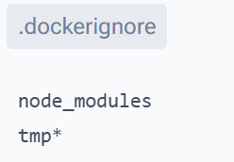
Keep the context small
The easiest way to make sure your context doesn't include unnecessary files is to create a .dockerignore.
Here's an example .dockerignore file that excludes the node_modules directory, all files and directories that start with tmp:

Slide 13
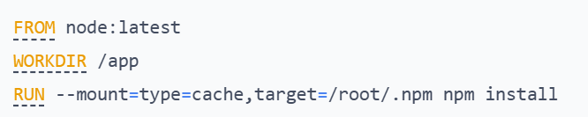
Cache mounts are a way to specify a persistent cache location to be used during builds.
This Dockerfile snippet is setting up a container for a Node.js application.
The --mount=type=cache,target=/root/.npm part is the key to speeding up future builds.

Slide 14
The --mount=type=cache option is used to create a persistent cache of the npm package manager's dependencies.
When you mount /root/.npm as a cache, Docker will store the downloaded dependencies in this location between builds.
Faster rebuilds: If the dependencies don't change, Docker can reuse the cached dependencies instead of downloading them again. This speeds up the build process significantly.
Efficiency: Only new or updated packages are downloaded when rebuilding the image, saving time and bandwidth.
In short, caching helps avoid unnecessary reinstallation of dependencies and speeds up the build process.

Slide 15
Use an external cache
External caches are helpful in CI/CD pipelines because the build environments are temporary, and build time is valuable. Reusing the cache between builds speeds up the process and cuts costs.
To use an external cache, you specify the --cache-to and --cache-from options with the docker buildx build command.
--cache-to exports the build cache to the specified location.
--cache-from specifies remote caches for the build to use.

Slide 16
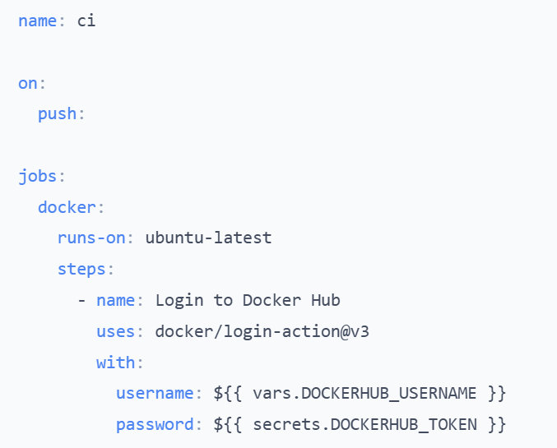
The following example shows how to set up a GitHub Actions workflow

Slide 17
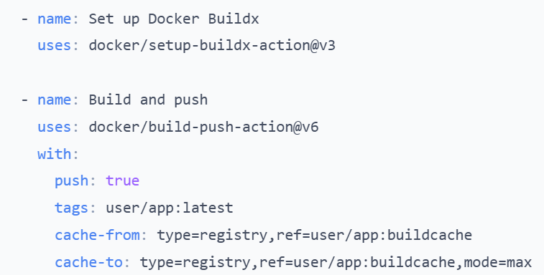
This setup tells BuildKit to look for cache in the user/app:buildcache image. And when the build is done, the new build cache is pushed to the same image, overwriting the old cache.

Slide 18

THANK YOU
Team –Foundations Of Cloud-native Computing & Devops

